Slide 1
BIE Alternate Science Assessment

Slide 2
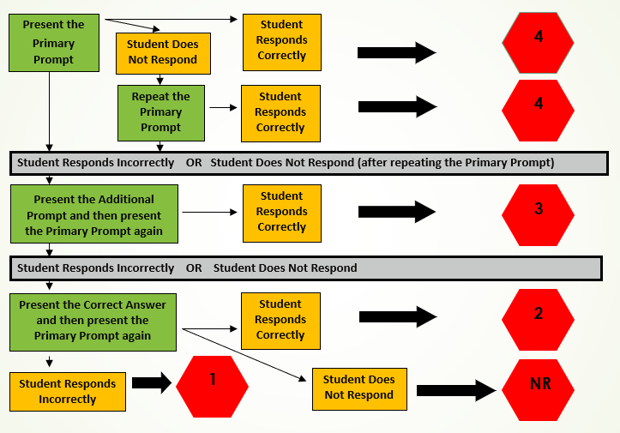
Interpretation of Overall BIE Alternate Scores

Slide 3
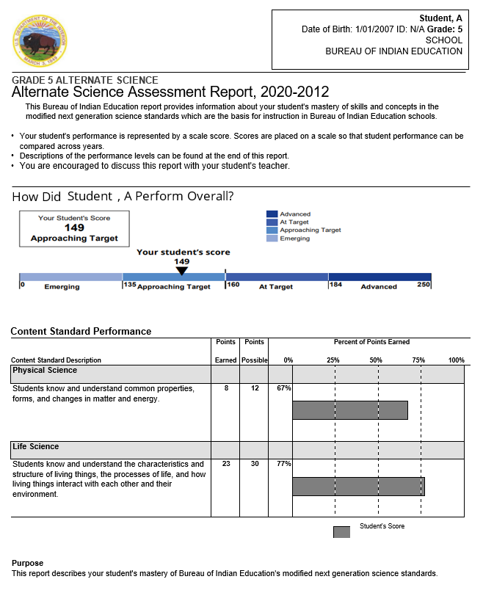
BIE Alternate Science Performance Levels
BIE Alternate Science has four performance levels
Advanced
At Target
Approaching Target
Emerging
Advanced and At Target are considered ready to continue academic study in the content area
Inconclusive Designation
Students who attempt the assessment, but do not respond to any items

Slide 4
BIE Alternate Science Performance Levels and Policy Claims
The Advanced and At Target levels are ready for continuing study in the content area
Advanced | Students performing at this level demonstrate a solid understanding of the concepts and skills represented by the Extended Evidence Outcomes (EEOs). They are academically well prepared to engage in further studies in the content area with appropriate supports.
At Target | Students performing at this level demonstrate a foundational understanding of concepts and skills represented by the EEOs. They are academically prepared to engage in further studies in the content area with appropriate supports.
Approaching Target | Students performing at this level demonstrate a limited understanding of concepts and skills represented by the EEOs. They will likely need moderate academic supports to engage successfully in further studies in the content area.
Emerging | Students performing at this level demonstrate an initial understanding of concepts and skills represented by the EEOs. They will need extensive academic supports to engage successfully in further studies in the content area.

Slide 5
BIE Alternate Science Performance Levels Cut Scores
BIE Alternate Science
Grade Level | Emerging | Approaching Target | At Target | Advanced
Grade 5 Alt Science | 0-134 | 135-159 | 160-183 | 184-250
Grade 8 Alt Science | 0-127 | 128-163 | 164-189 | 190-250
High School Alt Science | 0-139 | 140-163 | 164-192 | 193-250

Slide 6
BIE Alternate Science Reports
Student Performance Report
Intended for parents and teachers

Slide 7
BIE Alternate Science Student Performance Report
Scale Score
Overall test score
Range of 0 to 250

Slide 8
BIE Alternate Science Student Performance Report
Points earned and points possible are listed
Content standard descriptions are from the BIE and are the same as BIE
Performance level descriptions are found on page 4
The concepts and skills students in each performance level typically demonstrate for the assessed grade and content area

Slide 9
Pearson Resources

Slide 10
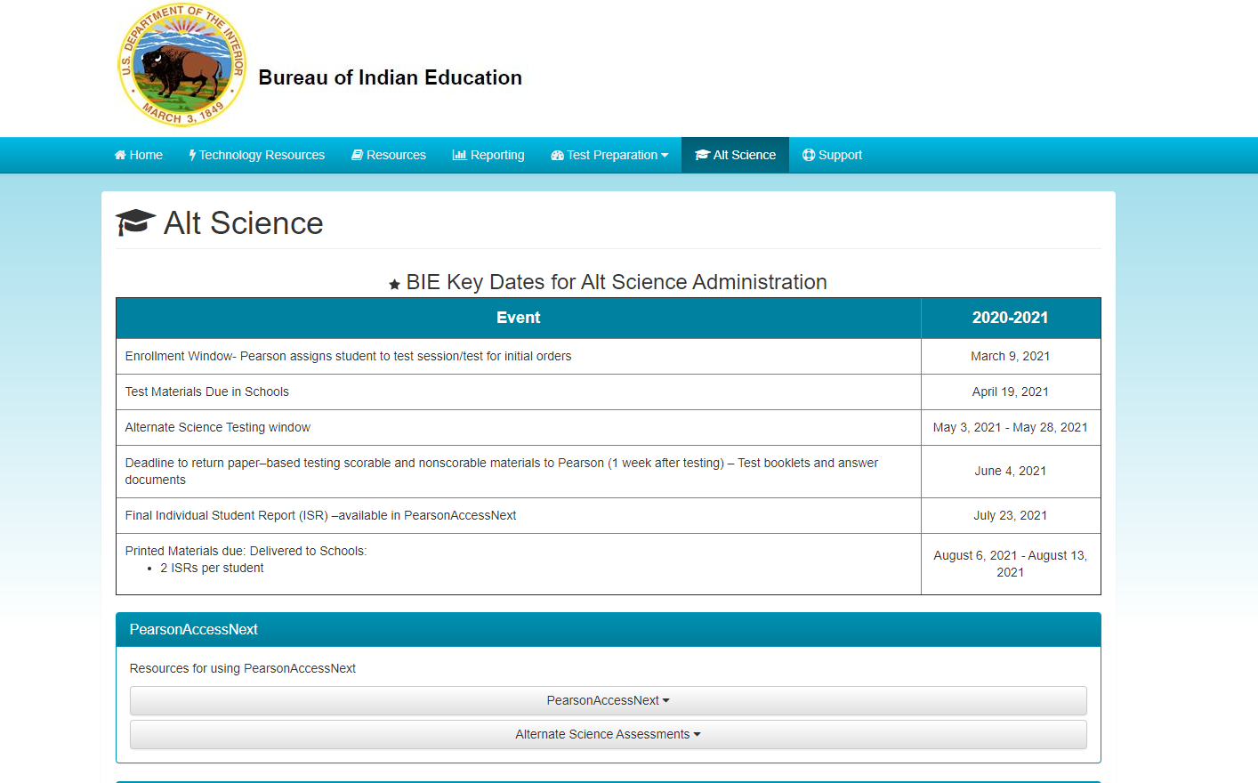
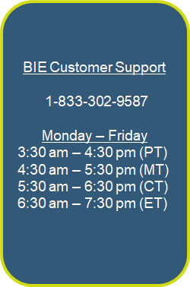
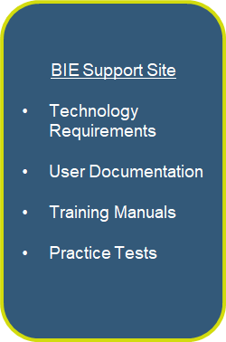
Pearson Resources
bie.mypearsonsupport.com/AlternateScience/

Slide 11
BIE Alternate Science Contacts
For General Questions related to the BIE Alternate Science Assessment:
Aurelia Shorty, Education Specialist in ADD Navajo, Aurelia.Shorty@bie.edu
Dr. Maureen Lesky, Program Analyst, Maureen.Lesky@bie.edu

Slide 12
Thank You

